Slide 1
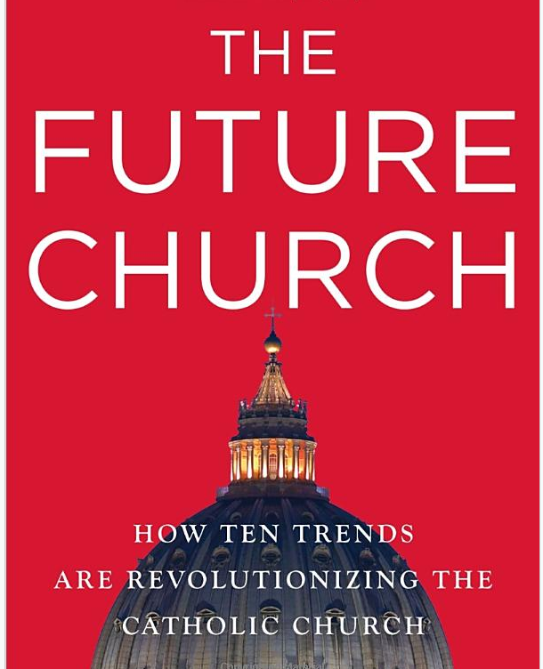
John L. Allen, Jr.. The Future Church: How Ten Trends are Revolutionizing the Catholic Church.
New York: Doubleday, 2009

Slide 2
1. An aging population.
“A Church that has historically invested a large share of its pastoral energy in the young now has to cope, beginning in the North, with the most rapidly aging population in human history.”

Slide 3
2. The rise of the laity.
Historically, the role of the laity was gradually restricted as power and service was passed to a professional clergy.
Lay movements didn’t disappear, but mostly, lay leadership was seen as supporting the professional leadership.
Today, in Christianity, lay leadership is expanding.

Slide 4
3. Issues too complex for one agency to address.
The gap between the rich and poor, war and the arms trade, human trafficking, political and organizational corruption, immigration and refugees, implications of technology, ecology, water shortage, lifestyle changes, biotechnology, aging, and social justice.
Each of these issues requires input from the theological institution’s community of scholars; each of these issues is too massive for theological institutions to address alone.

Slide 5
Though it remains to be seen how far and how fast populations will decline, John Allen cites the “U.N.’s ‘low scenario,’ which assumes that fertility rates will stabilize at 1.85 and stay there, will put the global population in 2300 at 2.3 billion, which would be a stunning decline by more than three quarters from where population levels are estimated to peak in the second half of the twenty-first century, around 9 billion.”
--John Allen, The Future Church (2009)

Slide 6
“The advanced industrial countries are on the cutting edge of the decline, but the rest of the world is following right behind them. And this demographic shift will help shape the twenty-first century.”
--George Friedman, The Next 100 Years (2010)

Slide 7
The Aging of the World
“The entire developed world and large parts of the developing world, including China, are in the process of getting much, much older. This won’t be a one-time event. The United States and its very best buddies will not only be getting old; they will be staying old.”
--Laurence Kotlikoff and Scott Burns, The Coming Generational Storm, 2004

Slide 8
Taro Aso, the former Prime Minister of Japan and current Finance Minister expressed concern about the “financial burden that caring for the elderly in their final years places on the country’s budget. Over a quarter of Japan’s 128 million people are above the age of 60 . . .”
TIME, February 4, 2013

Slide 10
“Korea, Russia, and China will join Japan as the world’s great geriatric nations. Mexicans will be older than Americans. Median ages will be higher everywhere, but Korea, Vietnam, Mexico, and Iran will age radically, by fifteen years or more. Only our poorest, least-developed countries—like Afghanistan, Somalia, and the Democratic Republic of Congo—will still have youthful populations in 2050; and even they will be somewhat older than today.” (Laurence Smith)
The median age in many if not most Middle Eastern nations “will increase 15 to 20 years by the middle half of the twenty-first century.” (John Allen)

Slide 11
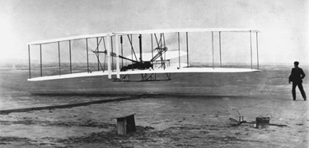
The Wright Brothers First Flight (1903)
-- Footprints to a new age

