Slide 1
International Partnerships

Slide 2
Perspective: The challenge for the 21st century is for institutions to learn how to relate to and work with other institutions—in a world shaped by networks or webs of organizations.

Slide 3
Explore a way for participants to experience mutual partnership.
For example, imagine a consortium, a framework for research and development . . .

Slide 4
ATS Member Schools
Currently, about 275 theological schools, most relatively independent. Most financially stressed.
A consortium committed to R&D
A few theological institutions willing to release time of selected faculty to a funded R&D experience

Slide 5
Cluster of organizations participating with theological institutions
A synergy of collaborating agencies is essential in light of 21st century realities.
CONSORTIUM
Selected leaders from various agencies become part of an R&D group (e.g., churches, international agencies and theological schools, nonformal leader development agencies).

Slide 6
Theological schools in the Consortium release selected faculty from various disciplines to participate in a funded R&D group.
Other participating agencies release selected leaders to participate in a R&D group.
R&D group resourced by external and funded design team
Participating theological schools (domestic and international)
Participating international agencies
Participating nonformal leader development agencies
Participating churches
An expert design team, funded by a foundation, works with the group to create effective learning designs.
Group members participate for minimum of 6 months. More than one R&D group is possible.

Slide 7
Funded Design Team
* Works with R&D group(s)—as subject matter teams and/or interdisciplinary teams
* Elicits desired outcomes
* Brainstorms ideas re student engagement with subject(s)
* Helps to design effective evaluation of learning
R&D Group
R&D Group

Slide 8
The benefits of R&D flow back to members of consortium
What we have learned about various ways to engage men and women in learning, research, and real world applications.
What we have learned about financial alternatives.
What we have learned about evaluation of learning and practice.

Slide 9
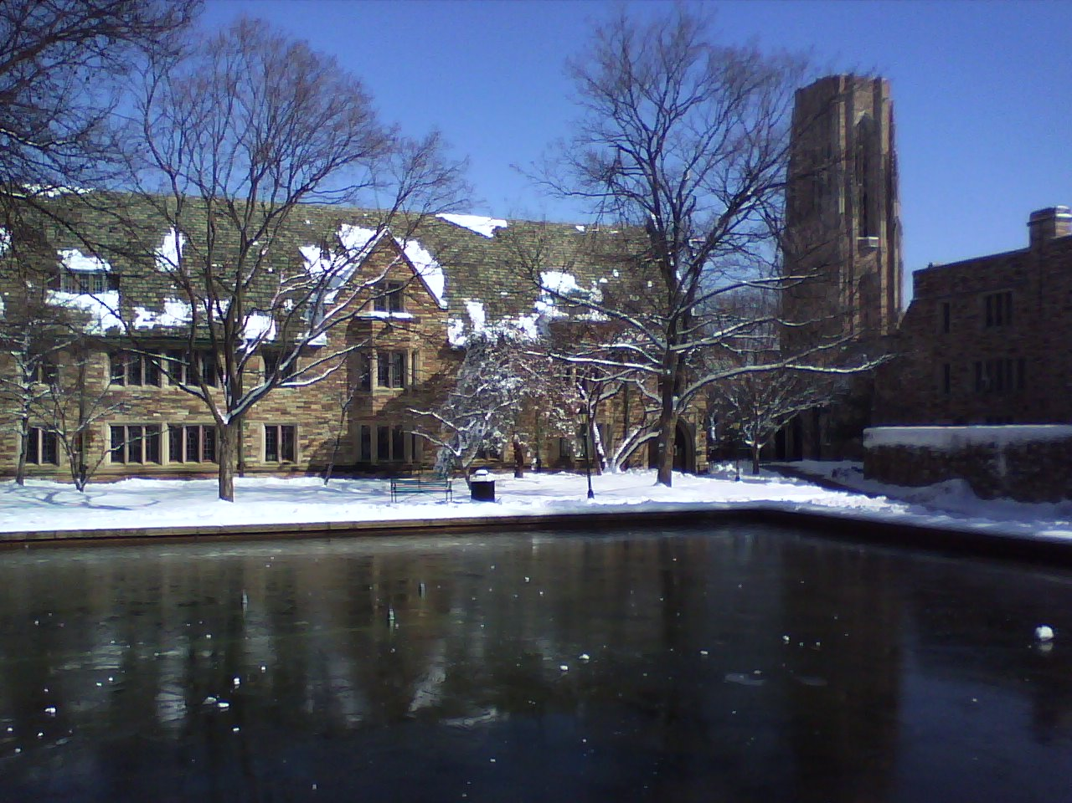
Explore theological schools as one aspect of theological education for the whole people of God.

Slide 10
Theological Education for the Whole People of God
Theological Schools
Churches
Mission agencies, other nonprofits, and others

Slide 11
PhD in
Theological
International
Education
2013

Slide 12
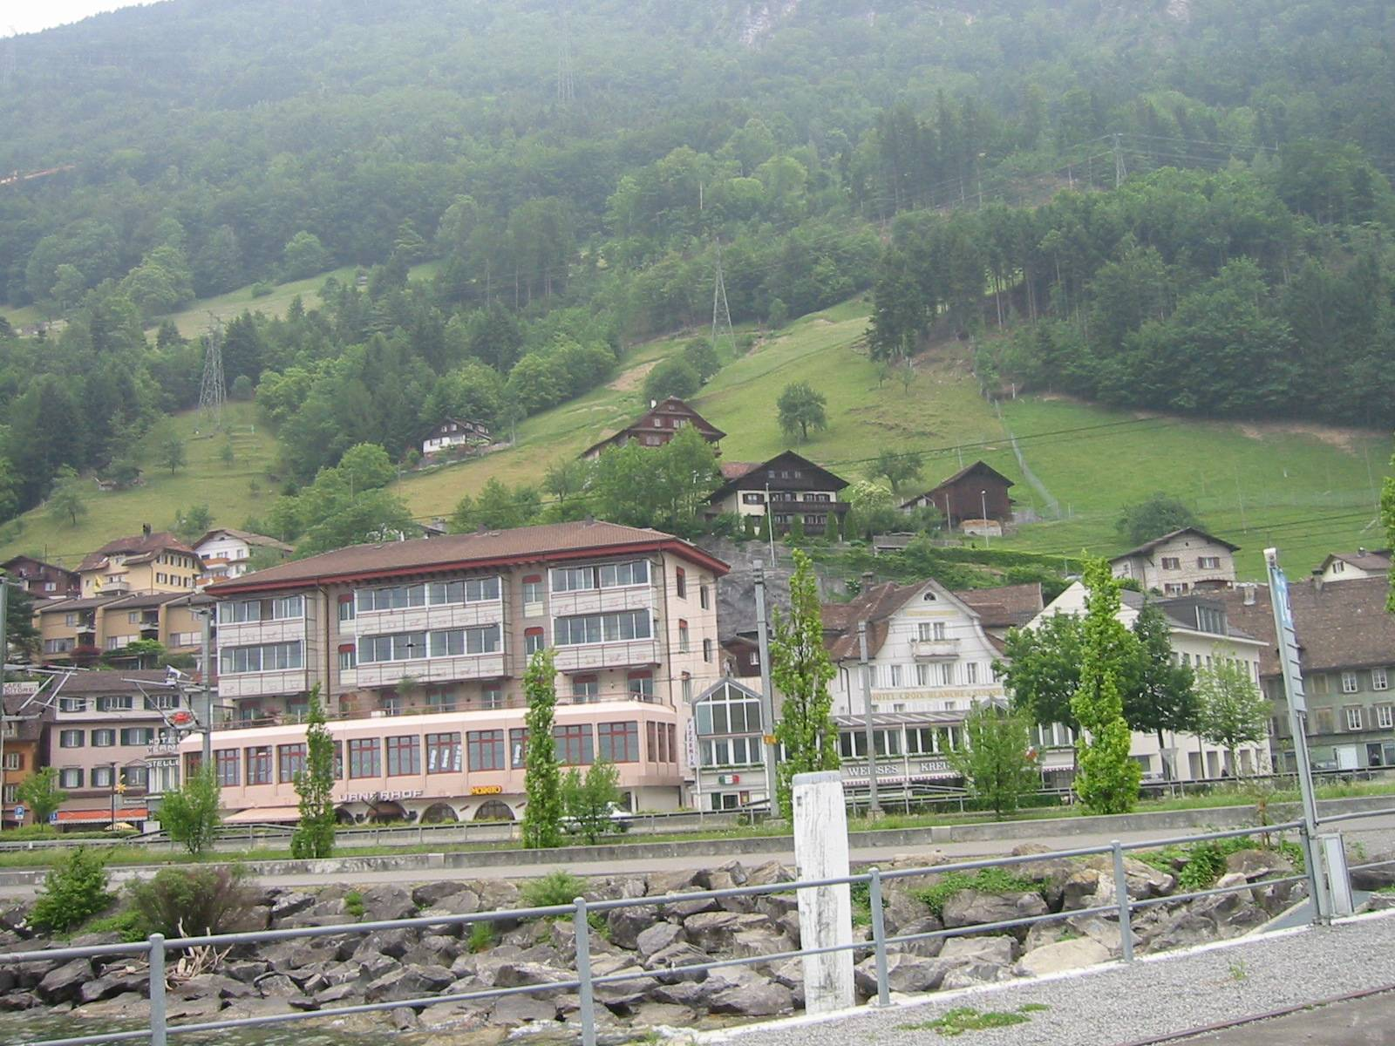
May 26-28, 2003.
About twenty representatives from theological schools internationally and foundations met in Brunnen, Switzerland. . .

Slide 13
. . . to discuss the creation of an International Consortium to offer a PhD that is different in emphasis and purpose, but not in competition with, classical PhD programs.

Slide 14
Why the PhD in International
Theological Education?

Slide 15
Theological school graduates inevitably become involved in academia – often without adequate training in education, little intercultural experience, and limited practice in interdisciplinary dialogue and reflection.
1
For an advanced degree, many often spend
years in another country. Some do not return to their home countries. An international consortium provides the option to remain mostly in one’s own context while taking advanced degree work.
2
Men and women who do advanced degree work in institutions that are oriented primarily to one dominant culture, report that their education does not serve them well on return to their own contexts.
3

Slide 16
May 2004.
A planning grant brought members of pilot schools to Chicago. Representatives were from New Zealand, Czech Republic, Kenya, United States, and Hong Kong.

Slide 17
Key Decisions from Chicago Conversations
Ethos and Intent
Participants become a community of learners engaged in scholarship and real-world applications of knowledge. This community is committed to service to the church; development of leaders who empower others; respect for cultural, ethnic, and gender difference; mutual respect, humility and service; responsible and rigorous search for truth; interdisciplinary research and application; and lifelong learning.

Slide 18
Key Decisions from Chicago Conversations (Con’t)
Program Emphases
The PhD in International Theological Education is organized around three areas:
Intercultural capabilities
Academic leadership and innovation, and
Critical reflection grounded in interdisciplinary interaction.
Emphases include the following:

Slide 19
Theological reflection and research: The development of theological reasoning and capacities in critical thinking.
Education: The development of the capacity to foster learning communities, to understand that which constitutes the nature of learning and evidences of learning.
Administration: The development of administrative competency and its application in different cultures and contexts.
International Expertise: The development of the capacity to embrace and explore differences from culture to culture.
Innovation: The development of skills to lead institutions in light of 21st century challenges and opportunities.

Slide 20
Key Decisions from Chicago Conversations (con’t)
Governance
Each institution will have secured recognition for offering the PhD degree by agencies in its own country; or be in process toward the PhD.
Procedures related to student information, coordination, planning, and funding will be determined in the pilot phase.

Slide 21
Key Decisions from Chicago Conversations (con’t)
Admission Criteria
In general, applicants will meet the admissions’ criteria for their home institution.
Criteria will include significant prior experience, and a master’s degree that represents one’s teaching and research interests, or equivalent.
Various subject matter interests will ensure that interdisciplinary inquiry will be one of the advantages of this PhD program.
The applicant’s organization or church will commit to financial and personal support.

Slide 22
Admission Criteria (con’t)
Pre-doctoral preparation, though encouraged, cannot be seen as the same for every student; and GPA scores are not to be trusted; therefore, in addition, students will demonstrate the following:
Language proficiency–English speaking capability. A language appropriate to a discipline, and/or a field language will be expected in the program. (English speakers, will be expected to learn another world language.)
Research proficiency–demonstrated ability in reading, writing, critical thinking.
Interpersonal proficiency–demonstrated capacity to engage others in discourse across cultures, organizations, disciplines.
A qualifying examination and/or interview.

Slide 23
Key Decisions from Chicago Conversations (con’t)
Enrollment
Provisional entry is granted for one year or until completion of a specified number of credit hours. Participants will be enrolled in an existing PhD program in one institution, with sufficient flexibility in that program to allow participation in experiences designed to fulfill the intentions of the international PhD.
Participants are enrolled at all participating institutions for purposes of credit transfer.

Slide 24
Key Decisions from Chicago Conversations (con’t)
Learning Evidences
Indicators of quality include an effective mentor-student collegial relationship, institutional credibility, procedures that indicate areas of program improvement, an acceptable completion rate, contributions from post doctoral professionals, the extent to which spirituality is fostered and community nurtured, and the extent to which men and women truly commit to the service of the church. Assessment for learning is consistent with intentions to foster deep understanding, sustainable habits of research and writing, and leadership capacities.
Each doctoral participant is helped to understand the academic, professional, and personal evaluative processes in each institution.

Slide 25
Key Decisions from Chicago Conversations (con’t)
Program Design
Each institution will provide some part of the core learnings for the degree, while drawing on the resources of the consortial members. Program design includes the following:
A seminar/colloquium design that consists of six modular courses (requiring advance reading).
A thematic seminar or other learning experience(s), 16 months in duration.
Completion of aspects of the program in two or more countries on at least two continents.
Participants return to their home contexts to communicate their learnings in their own context and language.
A dissertation.
Enrichment experiences—and lifelong learning

